Slide 1
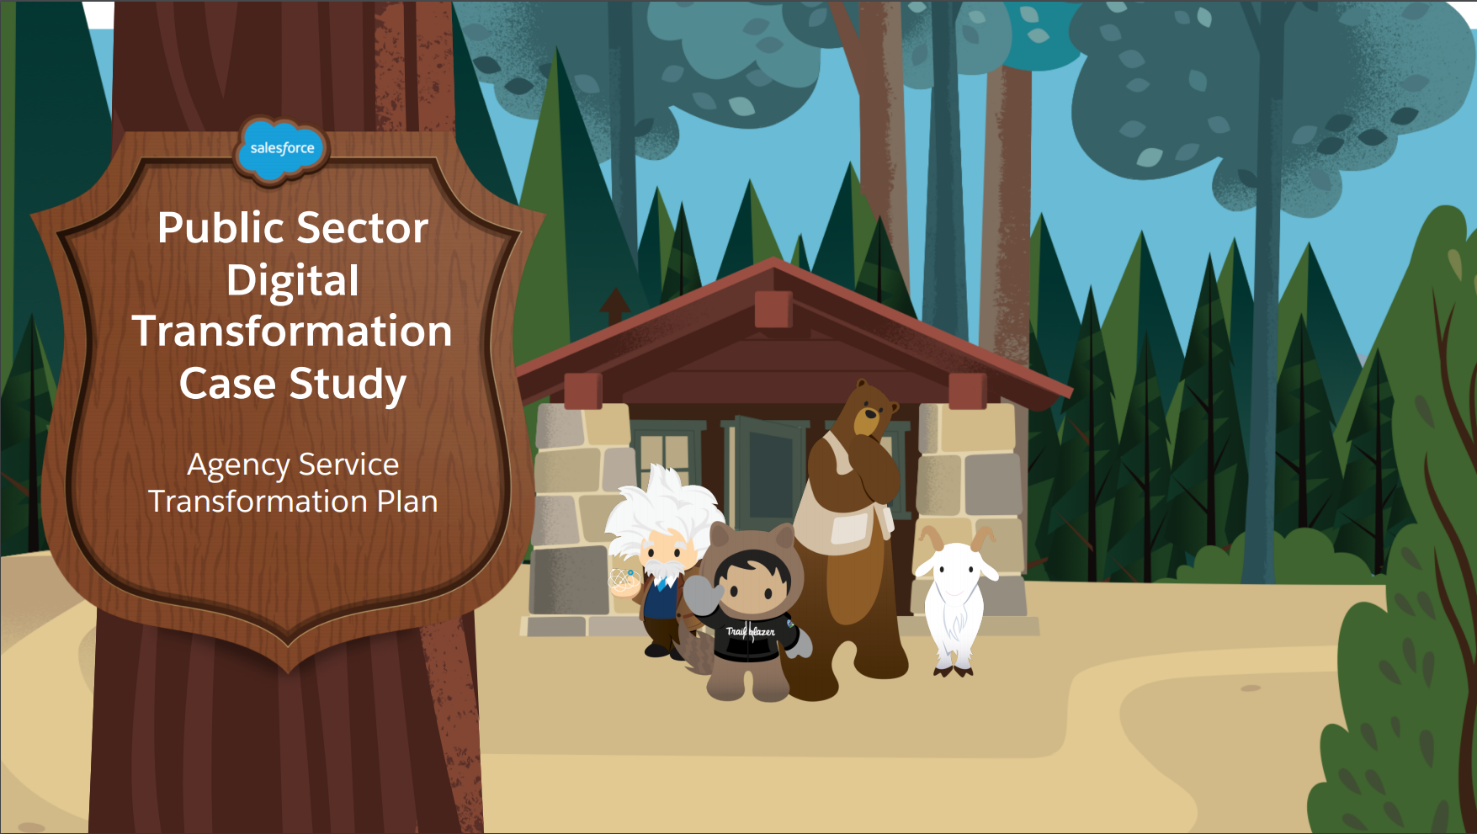

Slide 2
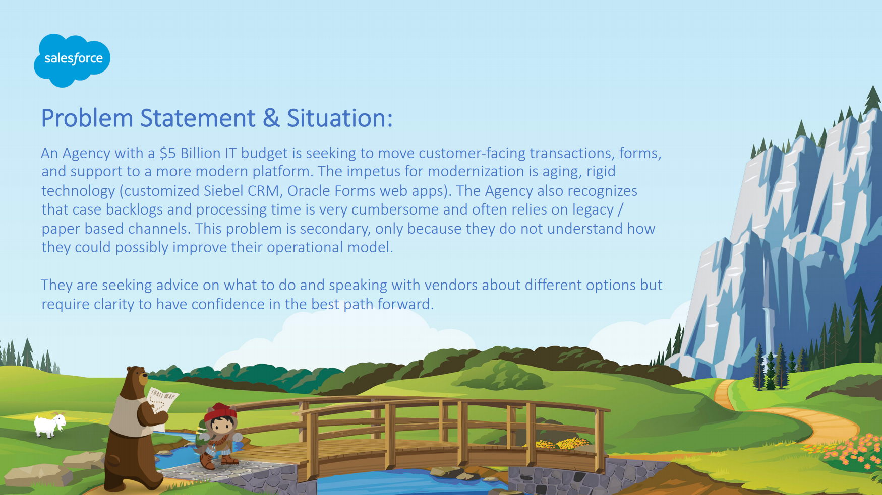

Slide 3
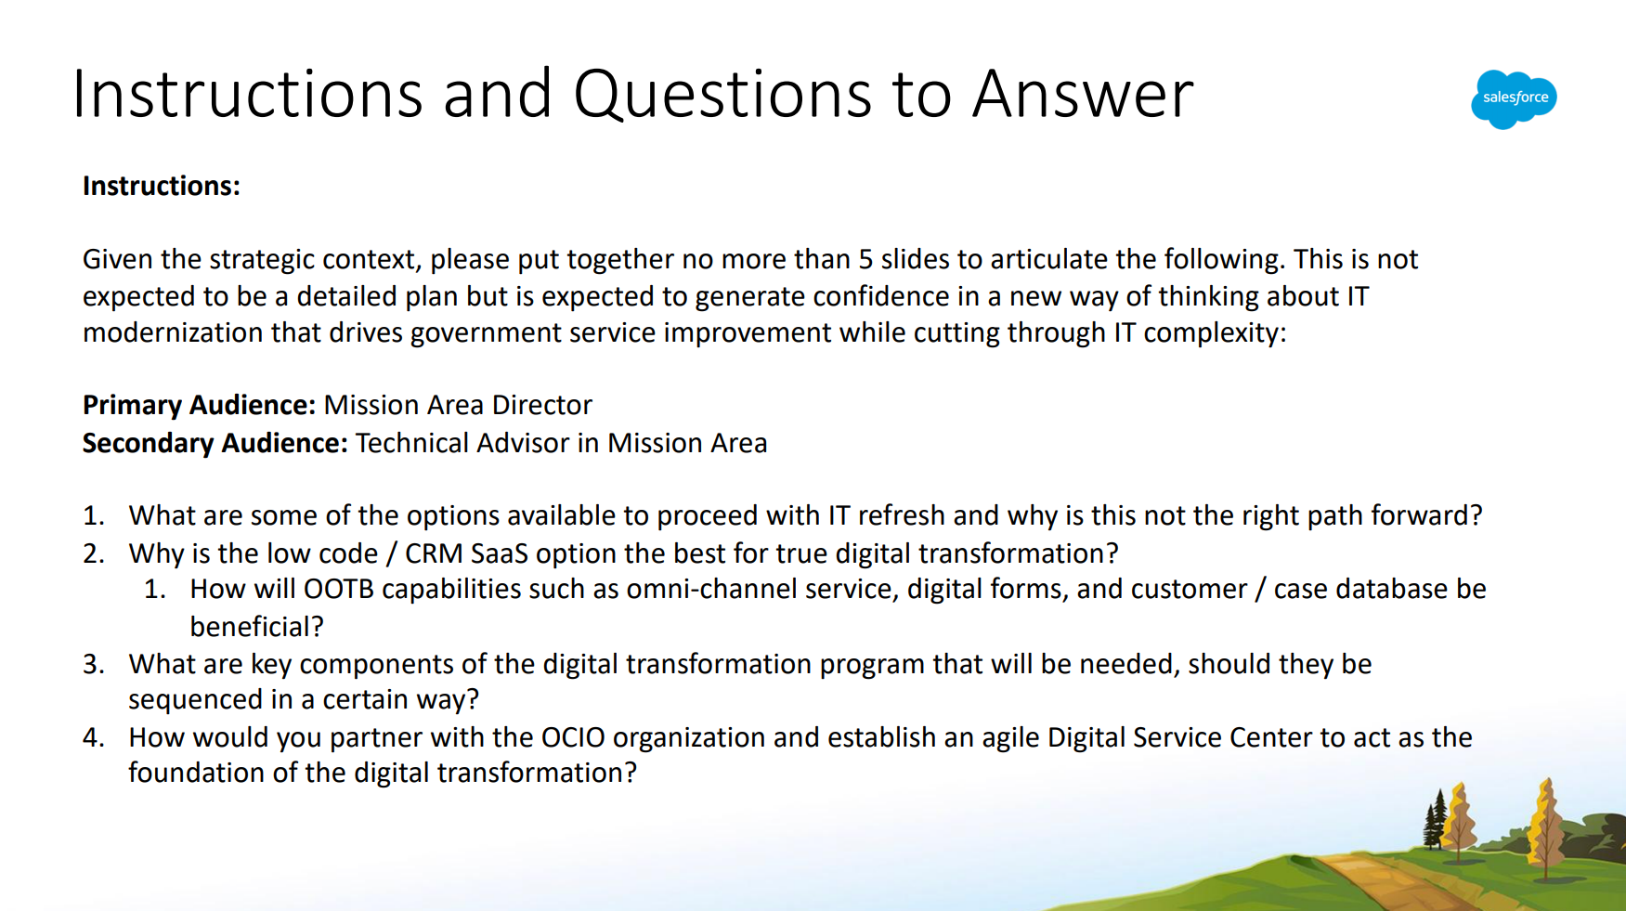

Slide 4
Notes:
[4th Wall] For the sake of analysis, I’ll be using an agency of a similar scale to you in order to ground our recommendations in research about a realistic environment.
Oh and Salesforce’s art is amazing…no need to compete with that, so this is strictly content, not design
I’m not here to pummel you with 20 reasons why Salesforce is the perfect fit for your situation.
My objective: beginning of a partnership as you further explore what digital transformation means at your agency and what it is going to take to get you from your current posture to the future state.
Alignment Sources
VA Strategic Plan: Agency Goals
VA OIT IRM Strategic Plan
VA Budget Highlights, Congressional Justifications, and CPIC data

Slide 5
Veterans Affairs Strategic Plan, 2018-2024
1
Veterans Choose VA For Easy Access, Greater Choices, And Clear Information To Make Informed Decisions
4
VA Will Transform Business Operations By Modernizing Systems And Focusing Resources More Efficiently To Be Competitive And To Provide World-Class Customer Service To Veterans And Its Employees
3
Veterans Trust VA To Be Consistently Accountable And Transparent
2
Veterans Receive Highly Reliable And Integrated Care And Support And Excellent Customer Service That Emphasizes Their Well-Being And Independence Throughout Their Life Journey
Easy Access
Clear Information
Excellent Customer Service
Throughout Their Life Journey
Accountable And Transparent
Modernizing Systems
World-Class Customer Service
https://www.ea.oit.va.gov/EAOIT/docs/July2019/VA2018-2024strategicPlan.pdf
Notes:
BOTTOM LINE
Effective approaches to these objectives have become increasingly commoditized in the private sector
Easier than ever to pick up those lessons and integrate them into government through low risk, rigorous solutions

Slide 6
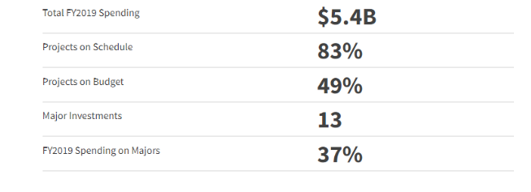
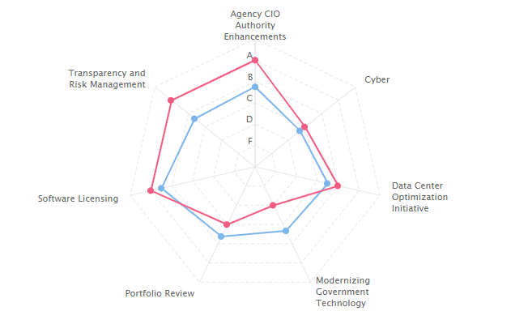
IT Context at Veterans Affairs
Budget Highlights
Veterans Experience Office
Human Centered Design & User Experience (UX)
VA OIT Investment Portfolio
IT Operations End User ($1B/year) committed to using cloud, particularly SaaS
IT Operations Enterprise Infrastructure ($647M/year) selected for cloud migration
IT Operations Data Center and Cloud ($371M/year) have allocated $119M for PaaS solutions
Modernization Legislation FITARA, MGT, 21st IDEA Act
VA IT Infrastructure lacks DME funding
IT Working Capital Fund & unobligated O&M spending (OMB M-18-12)
VA IT Portfolio (2019)*
*2020 data expected Feb/Mar
FITARA Scorecard (Dec 2019)
VA
GOV AVG
https://itdashboard.gov/drupal/summary/029
https://fitara.meritalk.com/view/va
https://oversight.house.gov/legislation/hearings/fitara-90
Notes:
[VA Assistant Secretary for Information and Technology and Chief Information Officer] [James Gfrerer]
One of the strongest CIO authorities environments in government and in many ways was the model for the FITARA legislation empowering CIOs elsewhere
Critical to identify ways to partner with OIT to solve mission & program priorities
VEO has invested in customer experience surveys across VA programs, establishing a baseline and multiple years of observations so far.
VA budget identifies building on HCD & UX as key priorities.
FITARA
Overall, VA is #4 out of all CFO Act agencies in access to DME for IT. However: Only 5% of VA IT infrastructure investments is budgeted for DME)
Highlights VA IT Working Capital Fund opportunity for unallocated O&M spending (OMB M-18-12)
DOL WCF: “Modernize Legacy Applications. Among other activities, OCIO will develop an enterprise-level, cloud-based case management platform which save money spent on duplicative systems, improve processing time of adjudication claims, and improve program integrity through the sharing of case information between agencies.”
21st Century IDEA Act
is accessible to individuals with disabilities in accordance with section 508 of the Rehabilitation Act of 1973 (29 U.S.C. 794d);
has a consistent appearance;
does not overlap with or duplicate any legacy websites and, if applicable, ensure that legacy websites are regularly reviewed, eliminated, and consolidated;
contains a search function that allows users to easily search content intended for public use;
is provided through an industry standard secure connection;
is designed around user needs with data-driven analysis influencing management and development decisions, using qualitative and quantitative data to determine user goals, needs, and behaviors, and continually test the website, web- based form, web-based application, or digital service to ensure that user needs are addressed;
provides users of the new or redesigned website, web- based form, web-based application, or digital service with the option for a more customized digital experience that allows users to complete digital transactions in an efficient and accurate manner; and
is fully functional and usable on common mobile devices.

Slide 7
True Digital Transformation
Builds into the organization the capability to continuously…
discover customer needs and
act on those opportunities.
Key Components
Put customers at the center, validated through observable metrics
“Build, measure, learn…repeat”
Partner across stakeholder domains (mission, IT, acquisition, etc)
Empower mission & programs, closer to customer, to guide features
Start small, in well-understood domains, including internal customers
Incorporate cybersecurity at the platform layer (FedRAMP)
With partners, establish key principles up front that the effort will use as reference points
Select a digital model that easily incorporates improvements and the above…
Notes:
“seeking to move customer-facing transactions, forms, and support to a more modern platform.
The impetus for modernization is aging, rigid technology (customized Siebel CRM, Oracle Forms web apps).
The Agency also recognizes that case backlogs and processing time is very cumbersome and often relies on legacy / paper based channels. “
===========
HUMILITY to put customers ahead of experts who know best
B M L…rept, RATHER: than documenting all the requirements perfectly up front—the classic fiction that puts federal IT projects onto a troubled path.
Build, measure, learn…including by building external reports into your continuous validation process
FedRAMP: If you build an addition to your home, you need to make sure its locks and windows are high security. But if you’ve built a state of the art wall around the home, your additions do can make additions with less intensive security investments and reviews. FedRAMP certifies that the platform itself has that wall built around it.
====

Slide 8
Salesforce CRM Out of the Box
KEY RELEVANT CAPABILITIES |  | KEY RESULTS
Not starting from scratch: access on Day One to decades of learning what works for today’s customers New features & improvements rolled out at no additional cost, within secure platform Continuous learning from the entire Salesforce-enabled ecosystem Omnichannel approach across end user services accelerates customer interactions, reduces customer data entry, improves & simplifies reporting License model fits an O&M budget portfolio and addresses key risks Mobile, accessibility, search, secure connection, consistent appearance, FedRAMP fully integrated |  | 360-degree visibility into Customer Journey Personalized, modern, familiar, online access Flexibility vs Rigidity Customer Empathy Reduce customer burden (time & repetition) Adapt quickly to customer feedback Rapidly incorporate new improvements Easy, timely, accurate reporting Low code, low developer needs, high involvement of mission & program experts Meets 21st Century IDEA Act requirements out of the box
Notes:
SF has years of experience learning how to delight customers, and that is all incorporated into the platform itself, and you get it all out of the box
The wide network of partners and organizations using SF contribute new learning and improvements back into the platform, which is rolled out to you at no additional cost
You’re signing up for continuous learning from the entire constellation of SF implementations out there, not boxing into just your learning
LICENSE MODEL
License model provides full functionality up front, replacing high risk DME spending with future predictable O&M spending--smoothing costs into future years
Can be more attractive to budget/CFO, lower risk, and retains flexibility to move in another direction and avoid vendor lock-in
INTEGRATED COMPLIANCE
21st Century IDEA Act (2018)
FISMA
KEY RESULTS
Enterprise learning: your customers visits are accelerated by learning from previous interactions and services, simplifying their interactions, reducing burden, and improving satisfaction
Enterprise reporting: when stakeholder interest and appetite for evidence, transparency, and accountability is high, being able to calculate, learn, and report from customer interactions across the whole enterprise is critical
Flexible enough to incorporate a variety of customer facing services, allowing the consolidation of potentially redundant spending into a common platform and achieve savings
Because the security and FEDRAMP is at the platform level, accelerates new enhancements reach your customers rapidly, without depending on new ATO and code reviews necessarily, or at least simplifying them
Data governance within the platform or through APIs to VA’s enterprise data warehouse or data centers
CONCLUSION
Instead of being reliant on the “technical” staff up front, configuration leverages mission staff and consequently is much closer to the program and customer preferences, experience, and feedback--accelerating and better aiming by reducing the hiccups in requirements management that come from translating mission needs into technical functions.
At VA OIT, this reinforces your existing strategy that has emphasized extensive program/mission expertise built up in OIT--VA OIT is less isolated from programs than many other agencies, giving it up a leg up on this closely integrated strategy and improving “fit” with salesforce--other agencies may be starting zero in building collaborative relationships with program officers
VA ahead of other agencies in CIO authorities, meaning it is less an uphill battle to ensure that the whole team is at the table, a key differentiator for what we’ve seen goes into IT success

Slide 9
Risks of Other Models
MODEL | ISSUES & RISKS
COTS | Risk of gap between product features and true customer requirements Cost of adapting/customizing to your environment may be significant
CUSTOM SYSTEM | Requirements risk High upfront costs, requires high early DME funding High reliance & risks placed on developer resources Risk of low portability and high vendor lock-in Pay for maximum capacity (not scalable) Standalone functionality may require frequent C&A, security reviews
CUSTOM SYSTEM DEPLOYED IN CLOUD-BASED IaaS | Above issues, but addresses scalability
Notes:
Highly Specialized Application or Technical Performance
When the challenge is highly specific single-use technical performance (think specialized supercomputing)
When Fragmentation of services is Okay
When fragmentation/specialization of services reflects highly fragmented independent customers who are very different from each other
In organizations with weak central standards for IT, this flexibility can be desirable for mission organizations
When fragmented reporting is okay
Okay if reporting needs are highly fragmented, but this can make a complete picture of timeliness, service, satisfaction challenging to calculate
When Redundancy is prioritized
When redundancy is more important than cost or other factors (emergency, defense, security…)
Highly Forgiving User Base
When just experimenting, non-consequential fiddling around
Highly forgiving user bases

